Slide 1
CS24110 Assignment
Dimitar Tasev [Dbt@aber.ac.uk]

Slide 2
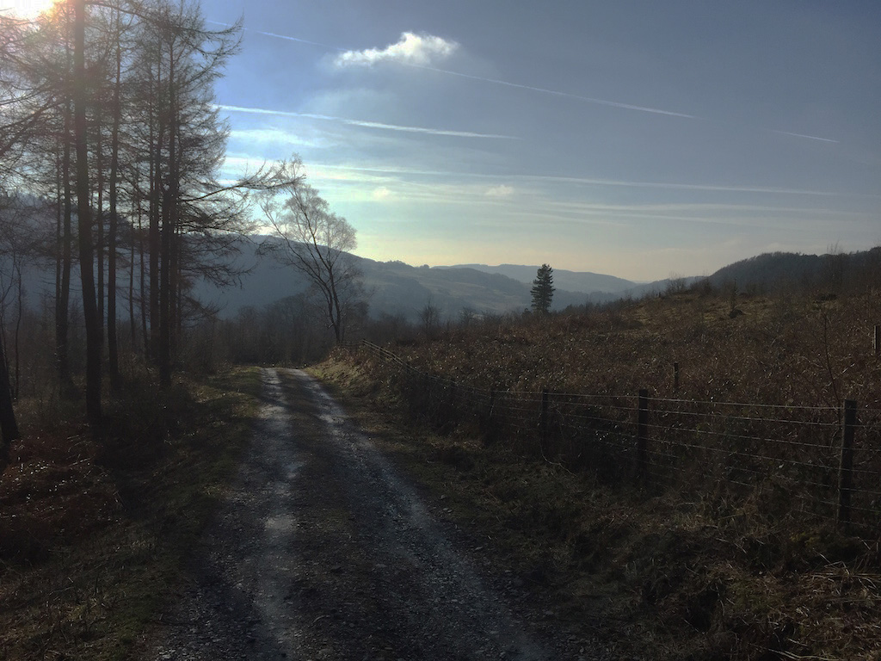
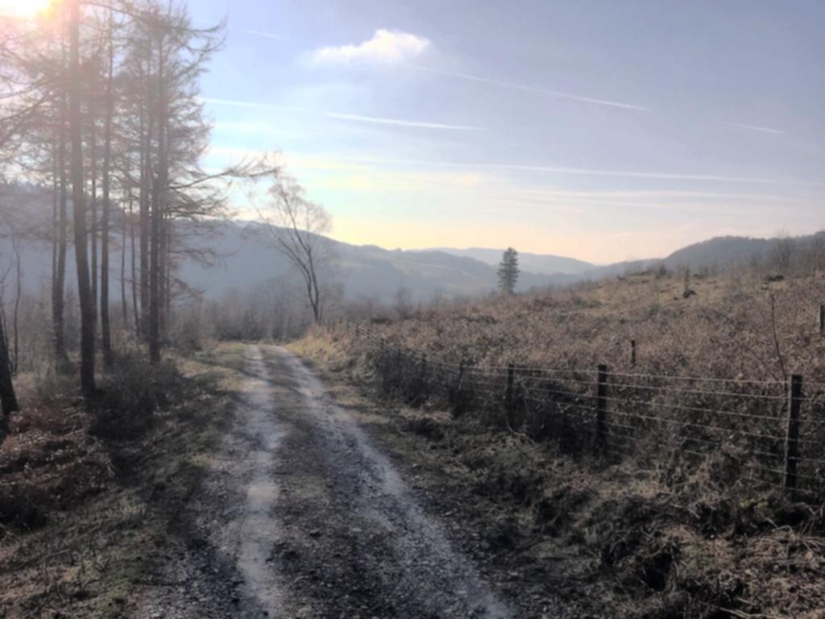
Beautify!

Slide 3
My Algorithm
Basic Idea

Slide 4
My Algorithm
Basic Idea
Operations

Slide 5
My Algorithm
Basic Idea
Operations
Automatic Contrast Adjustment

Slide 6
My Algorithm
Basic Idea
Operations
Automatic Contrast Adjustment
Luminosity Histogram Equalisation

Slide 7
My Algorithm
Basic Idea
Operations
Automatic Contrast Adjustment
Luminosity Histogram Equalisation
Average Value Blur Filter

Slide 8
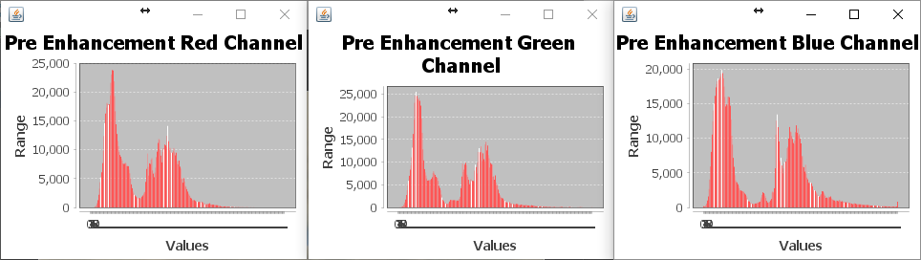
Automatic Contrast Adjustment
Image 02 Histograms, before enhancement

Slide 9
Automatic Contrast Adjustment
Image 02 Histograms, before enhancement

Slide 10
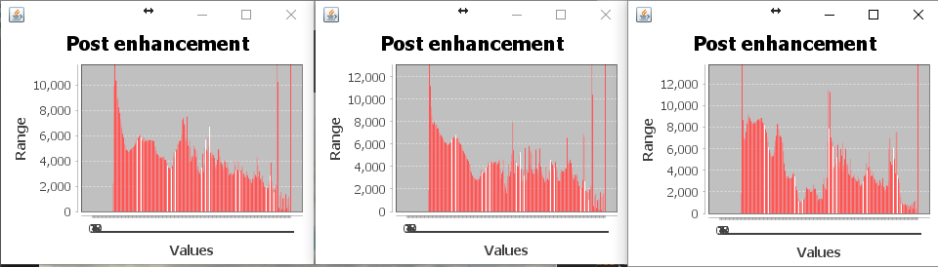
Automatic Contrast Adjustment
Image 02 Histograms, after enhancement

Slide 11
Automatic Contrast Adjustment

Slide 12
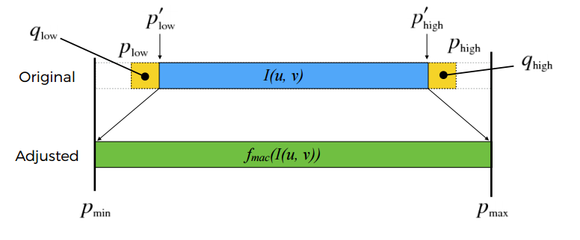

Slide 13
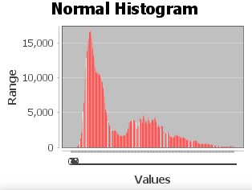
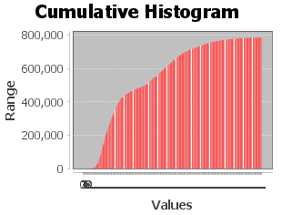

Slide 14
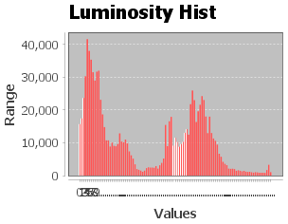
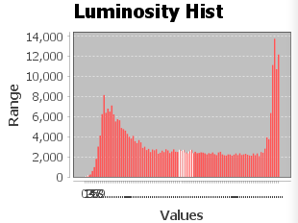
Luminosity Channel Histogram Equalisation
Histogram of a Dim Picture
(underexposed)
Histogram of a Bright Picture
(overexposed)

Slide 15
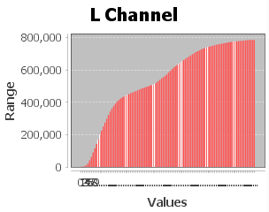
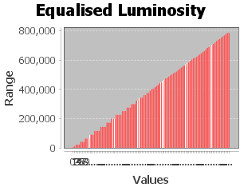
Luminosity Channel Histogram Equalisation
Before Equalisation
After Equalisation

Slide 16
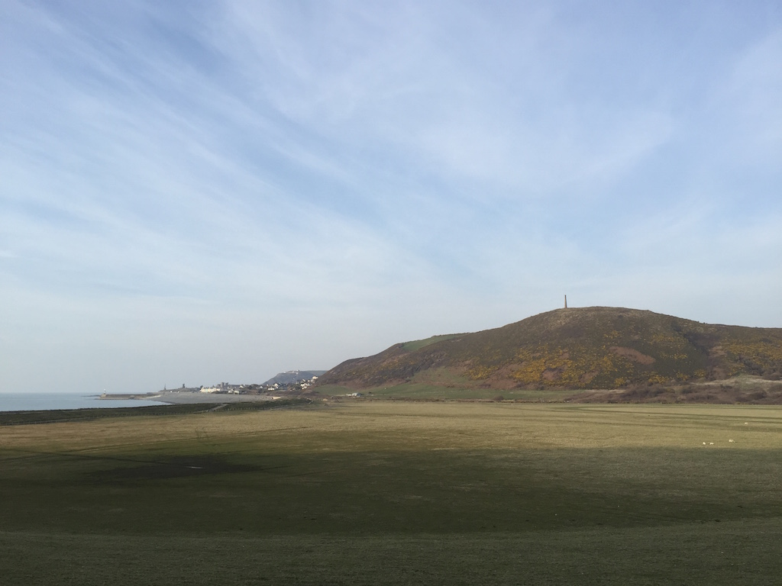
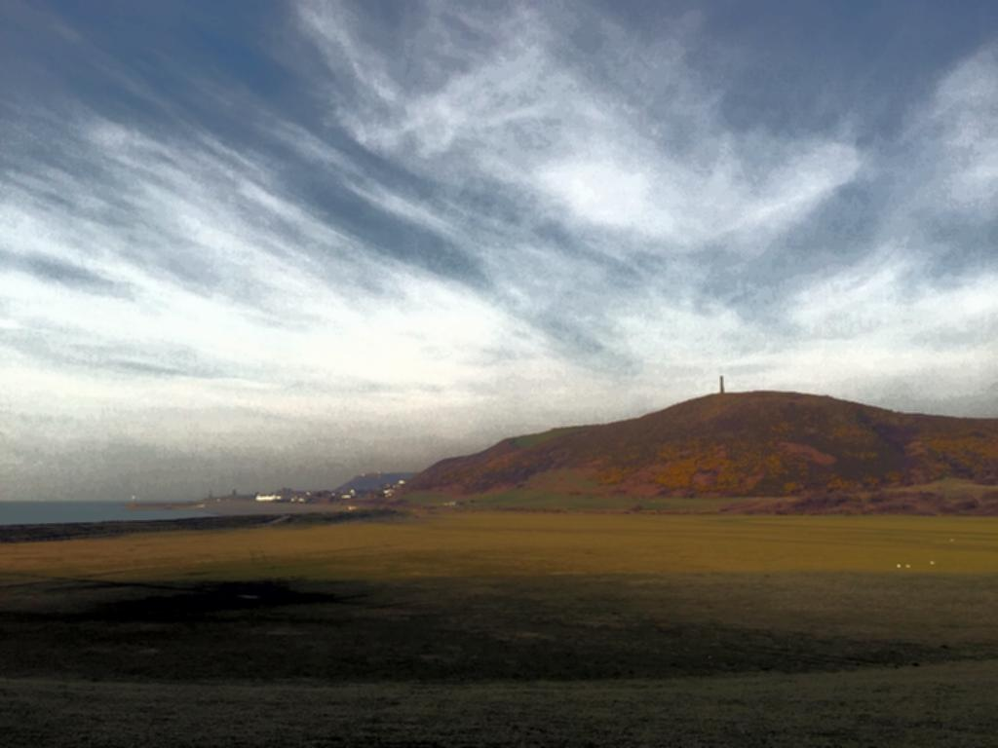
Average Blur Filter

Slide 17
Live Demo

Slide 18
Conclusions
The algorithm can sometimes produce
Change of colours, bringing out unwanted colours
Too much blur or unnoticeable blur
The algorithm will fix
Low brightness (dim picture)
Picture is a bit washed out

Slide 19
Critical Reflection
Overall the algorithm works good.
Changes should be made to the blur filter, so that it is consistent.
Edge Enhancement operation could be added.
Find a way to avoid the unnatural colours of the Automatic Contrast Adjustment

